Slide 1

AI-BASED PERSONAL FINANCE MANAGER WITH SMART EXPENSE PREDICTION SYSTEM
by
S. HEMANTH KUMAR
Roll No. 224G1A0528
B. JAHNAV ARJUN GOWD
Roll No. 224G1A0532
T. PAVAN
Roll No. 224G1A0567
Under the guidance of
Mr. P. SHAJAHAN, M.Tech.
Assistant Professor
Department of Computer Science and Engineering
Srinivasa Ramanujan Institute of Technology
Autonomous
Rotarypuram Village, B K Samudram Mandal, Ananthapuramu – 515701.
Accredited by NBA & NAAC with “A” Grade, Affiliated to JNTUA,Ananthapuramu
2025-2026
Srinivasa Ramanujan Institute of Technology

Slide 2
Comments
AI-Based Personal Finance Manager with Smart Expense Prediction System
What if a user enters incorrect expense data?
How does the system predict future expenses?
How does the system show spending trends?
What happens if a user spends more than their budget?
Srinivasa Ramanujan Institute of Technology

Slide 3
Contents
AI-Based Personal Finance Manager with Smart Expense Prediction System
Abstract
Introduction
Literature Survey
Existing System
Proposed System
Planning
Design
Implementation
Research Paper
References
GitHub Link
Srinivasa Ramanujan Institute of Technology

Slide 4
Abstract
AI-Based Personal Finance Manager with Smart Expense Prediction System
The AI-Based Personal Finance Manager with Smart Expense Prediction System is designed to help users manage their personal finances more effectively. Traditional expense tracking methods mainly record past transactions and provide limited support for financial planning.
To overcome this limitation, the proposed system provides a web-based platform where users can track daily expenses, manage budgets, and monitor savings goals. The system analyzes historical spending data and predicts future expenses using the Linear Regression algorithm.
The application also provides expense analysis and budget alerts, helping users understand their spending behavior and avoid overspending.
Srinivasa Ramanujan Institute of Technology

Slide 5
Introduction
AI-Based Personal Finance Manager with Smart Expense Prediction System
The AI-Based Personal Finance Manager with Smart Expense Prediction System is a web-based platform designed to help users manage their personal finances efficiently. It allows users to record daily expenses, categorize transactions, set budgets, and monitor savings goals. The system also analyzes financial data and predicts future expenses using machine learning techniques.
This project addresses the problems of traditional expense tracking methods such as manual record keeping, lack of financial insights, and difficulty in analyzing spending patterns. Many existing tools only store past transaction data and do not provide intelligent predictions or recommendations for financial planning.
This project is chosen to help users manage their finances more effectively by using a centralized digital platform. By integrating machine learning-based expense prediction and financial analysis, the system supports better budgeting, spending control, and informed financial decision-making.
Srinivasa Ramanujan Institute of Technology

Slide 6
AI-Based Personal Finance Manager with Smart Expense Prediction System
Literature Survey
No | Title | Author | Year | Methodology Adapted | Key Findings | Gaps
1. | AI-Powered Personal Finance Management: Predictive Analytics for Expense Forecasting | Sharma& Patel | 2023 | Machine learning models for expense prediction using financial data analysis | Predicts monthly expenses with high accuracy using historical spending patterns | Does not include full expense management and budgeting features
2 | Intelligent Budget Optimization Using Machine Learning Algorithms | Chen, L., & Williams, R. | 2022 | Machine learning techniques for dynamic budget optimization | Improves budget planning by analyzing user spending behavior | Limited focus on user-friendly personal finance tracking
3 | NLP-Based Automated Expense Categorization in Financial Applications | Rodriguez, M., & Kim, J. | 2021 | Natural Language Processing for automatic transaction categorization | Automatically categorizes expenses and improves financial data organization | Does not provide expense prediction
Srinivasa Ramanujan Institute of Technology

Slide 7
Existing System
AI-Based Personal Finance Manager with Smart Expense Prediction System
Currently, many people manage their personal finances using manual methods such as notebooks, spreadsheets, or basic expense tracking applications. These systems mainly focus on recording past transactions but do not provide intelligent analysis or future expense prediction.
Key Features:
Manual recording of daily expenses
Basic expense tracking using spreadsheets or simple applications
Manual categorization of expenses
Simple financial reports showing past spending
Budget planning done manually by users
Limitations:
No prediction of future expenses
Lack of intelligent financial analysis
Difficult to track long-term spending patterns
High chances of human error in manual records
No automated alerts for overspending or budget limits
Srinivasa Ramanujan Institute of Technology

Slide 8
Proposed System
AI-Based Personal Finance Manager with Smart Expense Prediction System
The proposed system introduces an AI-Based Personal Finance Manager with Smart Expense Prediction, a web-based platform designed to help users manage their finances efficiently and predict future expenses using machine learning techniques.
Key Features:
Web-based platform for managing personal financial activities
Secure user registration and login system
Recording and categorizing daily expenses
Budget management and savings goal tracking
Centralized database for storing financial records
Visual reports and dashboards for expense analysis
Srinivasa Ramanujan Institute of Technology

Slide 9
Proposed System
AI-Based Personal Finance Manager with Smart Expense Prediction System
Machine Learning-Based Expense Prediction
The system uses the Linear Regression algorithm to analyze historical spending data and predict future expenses.
Benefits of the Proposed System
Helps users plan budgets effectively
Provides insights into spending behavior
Generates alerts when expenses approach budget limits
Supports better financial decision-making
Srinivasa Ramanujan Institute of Technology

Slide 10
Planning
AI-Based Personal Finance Manager with Smart Expense Prediction System
The planning phase of the AI-Based Personal Finance Manager with Smart Expense Prediction System focused on identifying the challenges in traditional personal finance management and designing an intelligent solution to help users manage their expenses effectively.
During this stage, requirement analysis was conducted to understand the needs of users such as recording daily expenses, managing budgets, tracking savings goals, and analyzing spending patterns.
The system workflow was then planned to allow users to securely log in, add and categorize expenses, view financial summaries, and monitor their spending through a centralized web-based platform.
In addition, machine learning integration planning was included to analyze historical spending data and predict future expenses using a machine learning algorithm, helping users plan their finances more effectively.
Srinivasa Ramanujan Institute of Technology

Slide 11
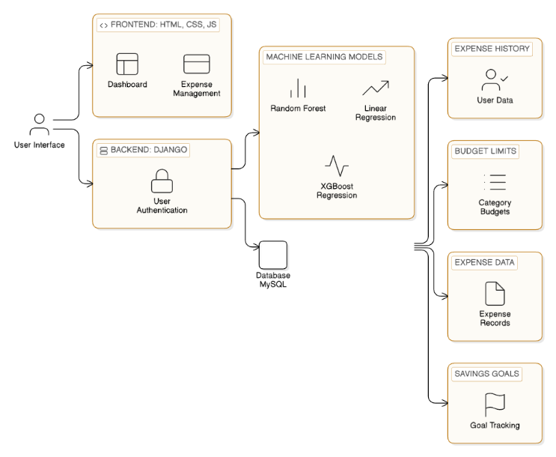
Design
AI-Based Personal Finance Manager with Smart Expense Prediction System
The AI-Based Personal Finance Manager with Smart Expense Prediction System is designed as a web-based platform that helps users manage personal and group expenses efficiently. The system allows users to track daily expenses, manage budgets, and analyze spending patterns. It also supports group expense management where multiple members can share and monitor expenses within a group. The system uses machine learning techniques to analyze historical spending data and predict future expenses.
1. System Architecture Design
The system mainly consists of three types of users: Admin (Group Admin), Members, and Individual Users.
Srinivasa Ramanujan Institute of Technology

Slide 12
Design
AI-Based Personal Finance Manager with Smart Expense Prediction System
Admin (Group Admin)
Creates and manages expense groups
Adds members to the group
Records and manages group expenses
Monitors total group spending and expense summaries
Members
View shared group expenses
Track their individual contributions in the group
Monitor spending records within the group
Individual Users
Register and log in to the system
Record and categorize personal expenses
Set personal budgets and savings goals
View expense summaries and predictions
Srinivasa Ramanujan Institute of Technology

Slide 13
Design
AI-Based Personal Finance Manager with Smart Expense Prediction System
2. Module Design
The system is divided into several functional modules:
Registration and Authentication Module
Handles user registration and login
Verifies user credentials
Stores user information securely in the database
Expense Management Module
Allows users to add, edit, and delete expenses
Categorizes expenses such as food, travel, bills, and shopping
Maintains records of daily financial transactions
Budget Management Module
Allows users to set monthly budgets
Tracks spending against the planned budget
Notifies users when spending exceeds limits
Srinivasa Ramanujan Institute of Technology

Slide 14
Design
AI-Based Personal Finance Manager with Smart Expense Prediction System
Expense Prediction Module
Uses a machine learning algorithm to analyze historical expense data
Identifies spending patterns and trends
Predicts future expenses to help users plan finances more effectively
Dashboard and Reporting Module
Displays financial summaries and expense statistics
Provides graphical reports of spending patterns
Helps users monitor their financial behavior over time
3. Database Design
A centralized database is used to store all system information:
User Profiles
Budget Details
Expense Categories
Prediction Results
Financial Reports
Srinivasa Ramanujan Institute of Technology

Slide 15
Design
AI-Based Personal Finance Manager with Smart Expense Prediction System
The centralized database ensures:
Secure storage of financial data
Efficient data retrieval and management
Long-term tracking of user financial activities
4. Expense Prediction Process
The expense prediction module performs automated financial analysis and prediction.
Steps involved:
Users enter daily expenses into the system.
The system stores historical expense data in the database.
The machine learning algorithm analyzes past spending patterns.
Future expense values are predicted based on historical trends.
Predicted results are displayed on the user dashboard for financial planning.
Srinivasa Ramanujan Institute of Technology

Slide 16
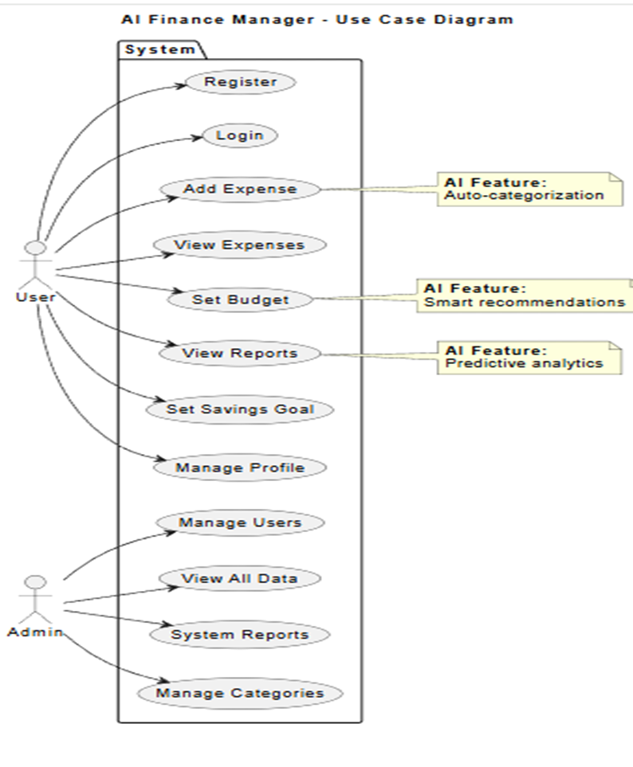
UML diagram of Use Case
AI-Based Personal Finance Manager with Smart Expense Prediction System
Actors: User (manage expenses, view reports, receive predictions) and Admin (manage groups and members)
1. User (End User) The person who uses the AI-Based Personal Finance Manager system to record expenses, set budgets and savings goals, view financial reports, and receive AI-based expense predictions.
2. Admin (Group Admin) The person who manages group expenses by creating groups, adding or removing members, tracking member expenses, and monitoring total group spending.
Srinivasa Ramanujan Institute of Technology

Slide 17
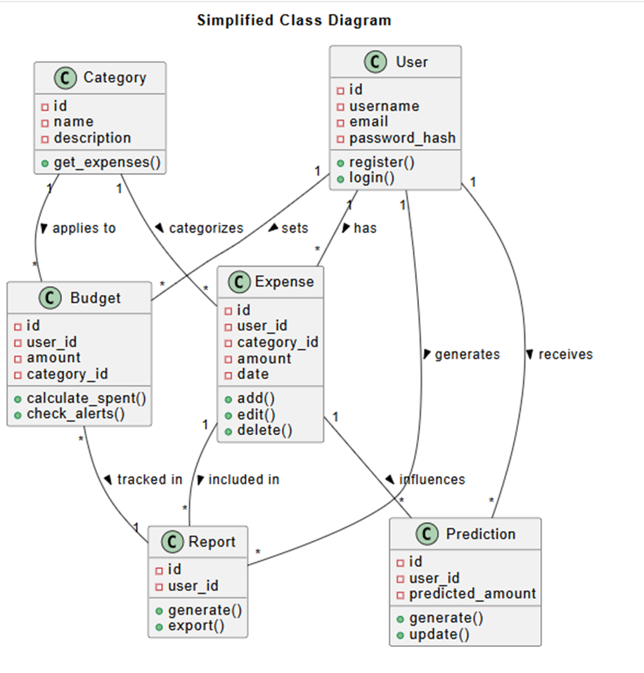
UML diagram of Class
AI-Based Personal Finance Manager with Smart Expense Prediction System
Our class diagram has 7 classes — User, Category, Expense, Budget, Report, Prediction, and Group.
Srinivasa Ramanujan Institute of Technology

Slide 18
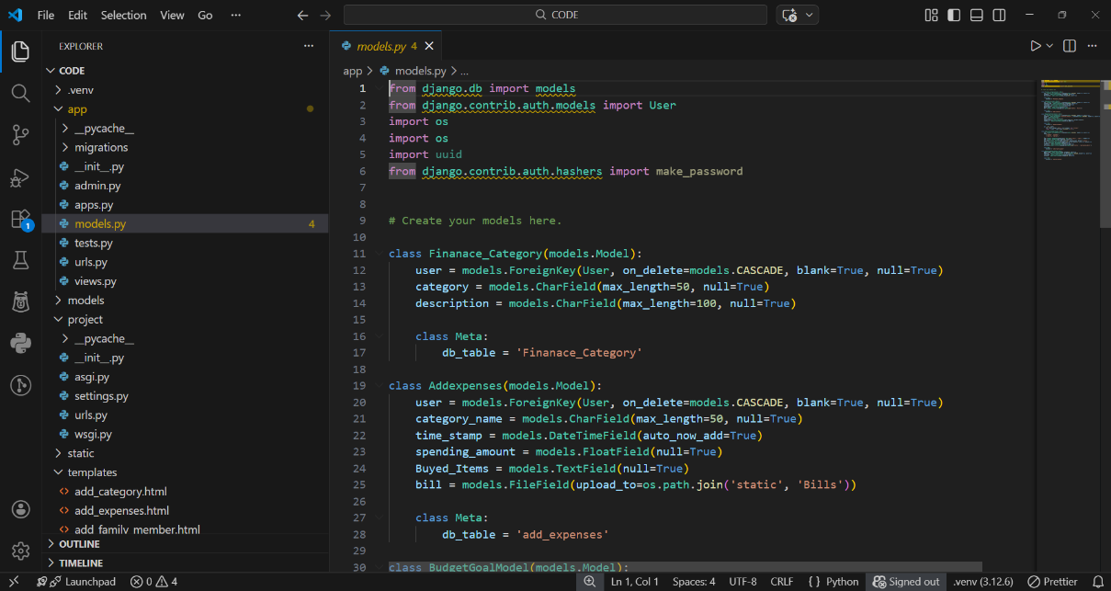
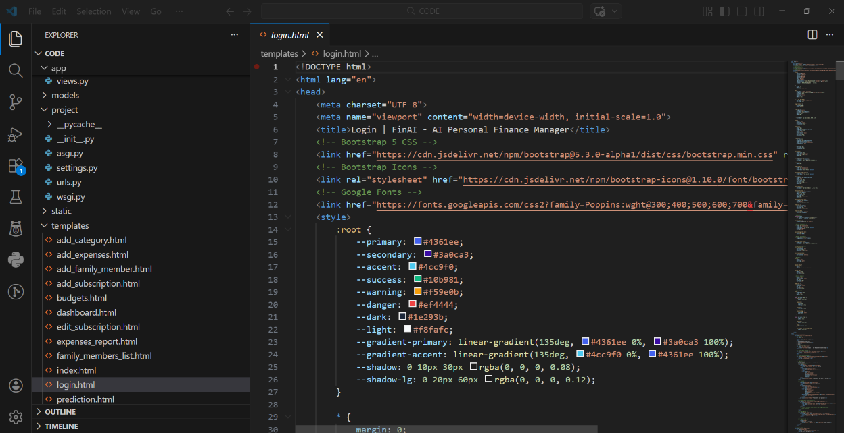
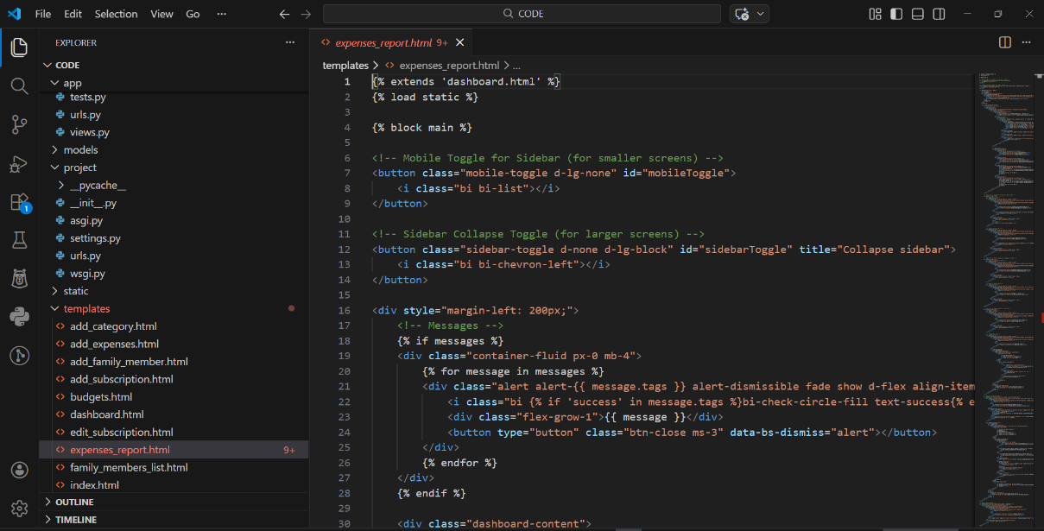
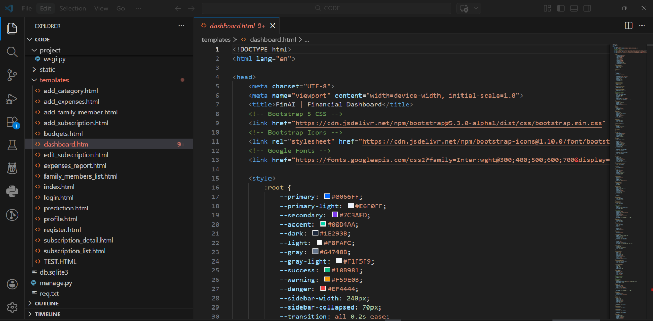
AI-Based Personal Finance Manager with Smart Expense Prediction System
Implementation
Srinivasa Ramanujan Institute of Technology

Slide 19
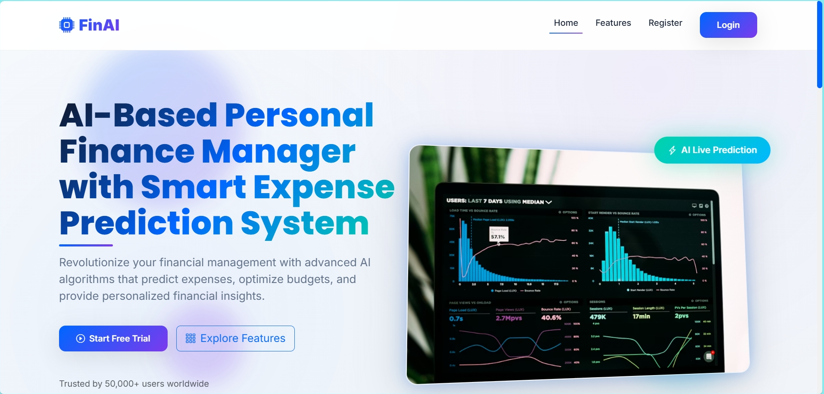
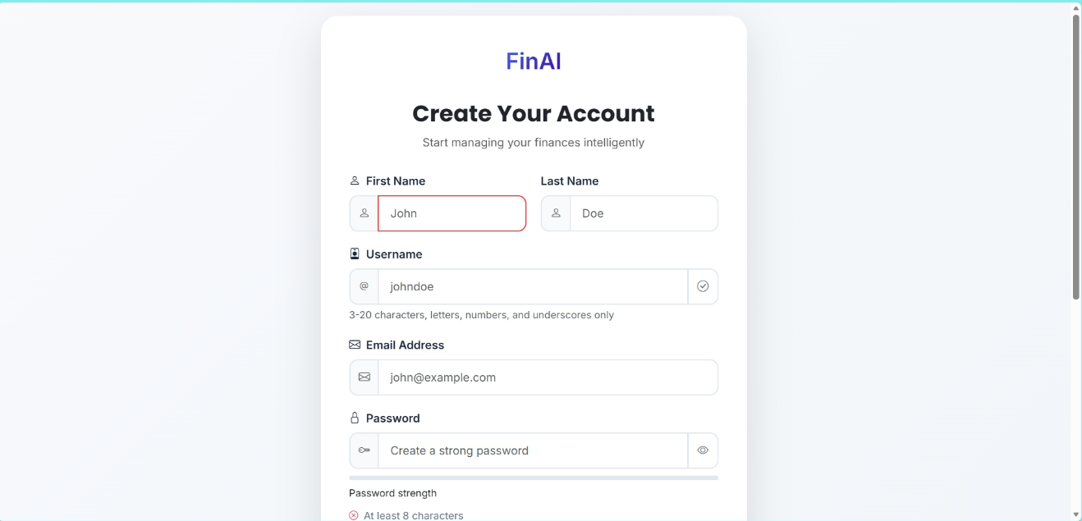
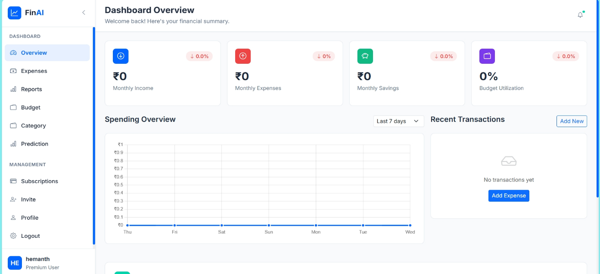
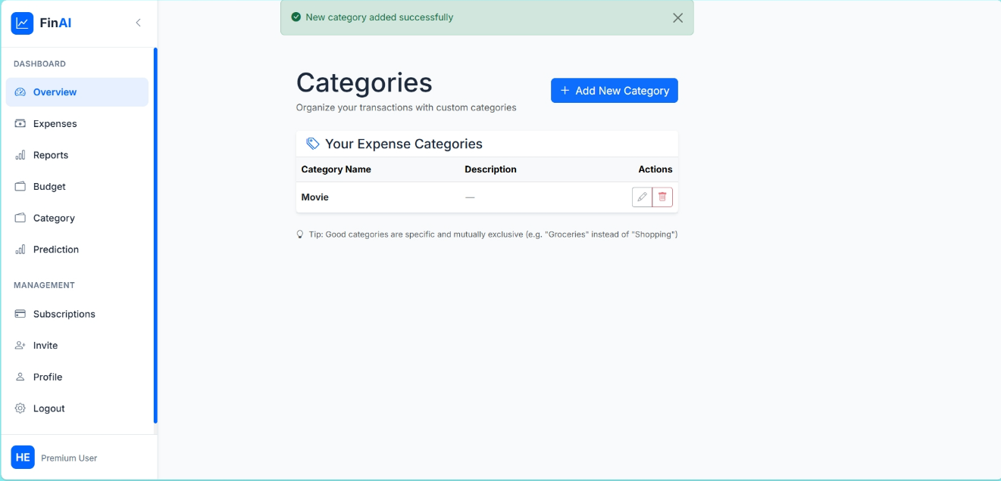
Outputs
AI-Based Personal Finance Manager with Smart Expense Prediction System
Srinivasa Ramanujan Institute of Technology

Slide 20
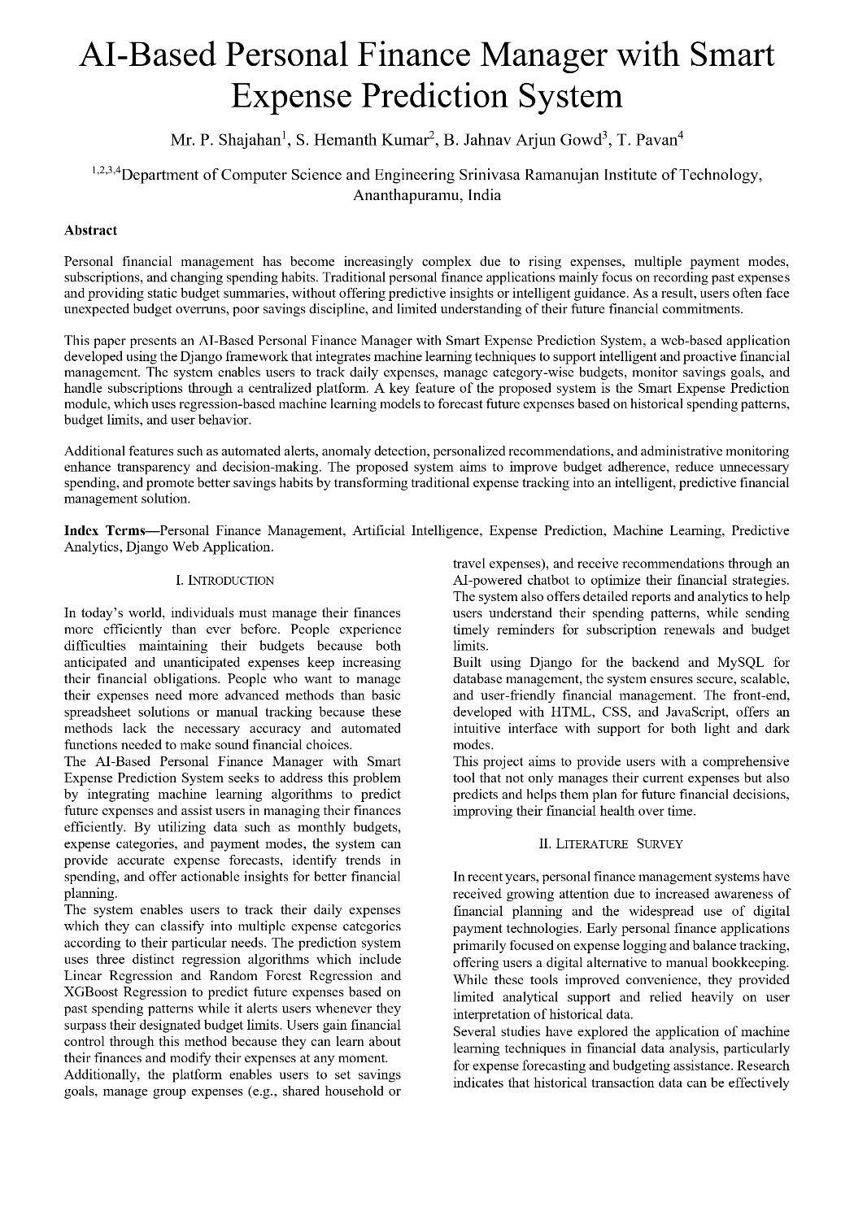
Research Paper
AI-Based Personal Finance Manager with Smart Expense Prediction System
Srinivasa Ramanujan Institute of Technology

Slide 21
References
AI-Based Personal Finance Manager with Smart Expense Prediction System
Books
[1] Ian Goodfellow, Yoshua Bengio, and Aaron Courville, Deep Learning. Cambridge, MA: MIT Press, 2016.
Journal Article
[2] L. Chen and R. Williams, “Machine Learning-Based Expense Prediction for Personal Finance Management,” International Journal of Data Science and Analytics, vol. 14, no. 2, pp. 85–97, March 2022.
Newspaper article
[3] “How Artificial Intelligence Is Transforming Personal Finance,” The Economic Times, vol. 183, pp. 12–13, June 10, 2023.
Technical Report
[4] Organisation for Economic Co-operation and Development (OECD), “Artificial Intelligence in Personal Financial Management and Consumer Decision-Making,” OECD Publishing, Financial Technology Technical Report OECD-AI-FIN-2021-07, July 2021.
Srinivasa Ramanujan Institute of Technology

Slide 22
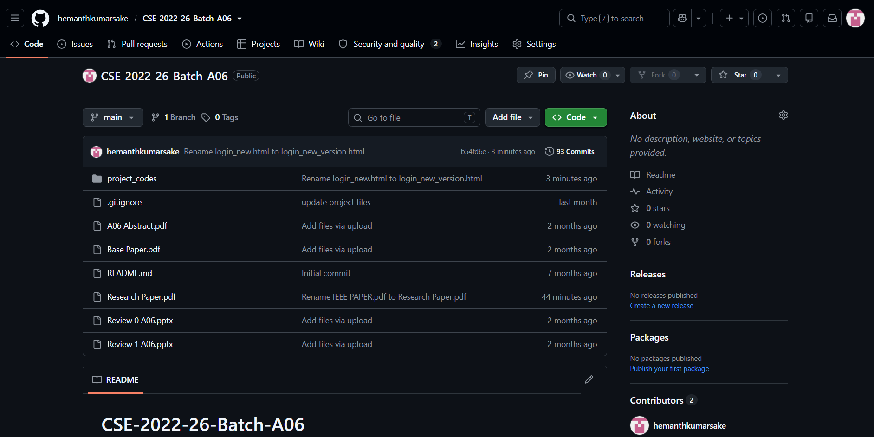
AI-Based Personal Finance Manager with Smart Expense Prediction System
GitHub Link
Git Hub Link: https://github.com/hemanthkumarsake/CSE-2022-26-Batch-A06
Srinivasa Ramanujan Institute of Technology

Slide 23
Thank You!!!
AI-Based Personal Finance Manager with Smart Expense Prediction System
Srinivasa Ramanujan Institute of Technology

Slide 24
Any Queries?
AI-Based Personal Finance Manager with Smart Expense Prediction System
Srinivasa Ramanujan Institute of Technology

